Slide 1
Distributed Systems
Ali Kamandi, PH.D.
School of Engineering Science
College of Engineering
University of Tehran
kamandi@ut.ac.ir

Slide 2
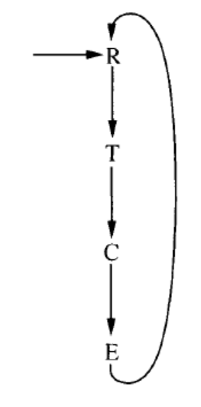
Mutual Exclusion
trying (trying to get into critical section)
critical (in critical section)
exiting (cleaning up so that other processes can enter their critical sections)
Remainder (everything else—essentially just going about its non-critical business)

Slide 3
Goals
Mutual exclusion At most one process is in the critical state at a time.
No deadlock (progress) If there is at least one process in a trying state, then eventually some process enters a critical state; similarly for exiting and remainder states.
No lockout (lockout-freedom): If there is a particular process in a trying or exiting state, that process eventually leaves that state. This means that I don’t starve because somebody else keeps jumping past me and seizing the critical resource before I can.
Stronger versions of lockout-freedom include explicit time bounds (how
many rounds can go by before I get in) or bounded bypass (nobody gets
in more than k times before I do).

Slide 4
1. Token-based approach.
2. Non-token-based approach.
3. Quorum-based approach.

Slide 5
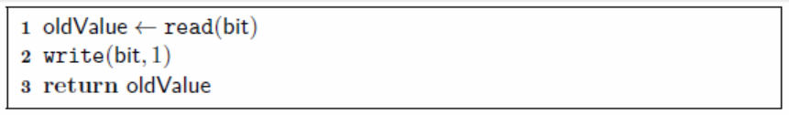
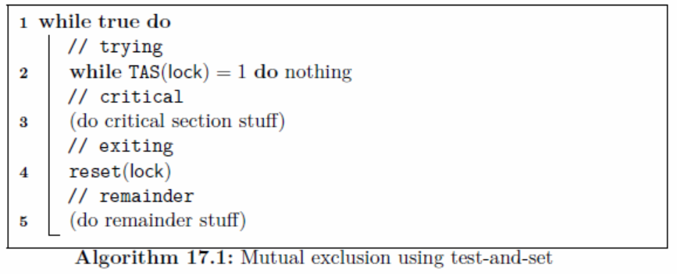
Mutual exclusion using strong primitives
Test and Set

Slide 6
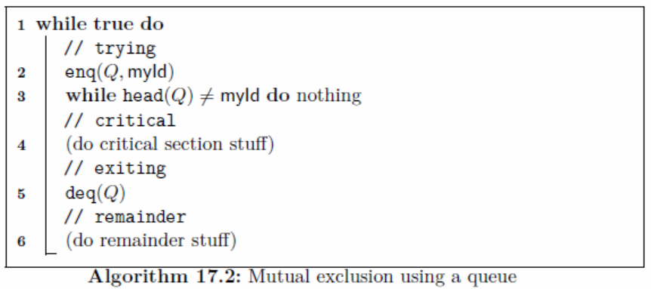
A lockout-free algorithm using an atomic queue

Slide 7
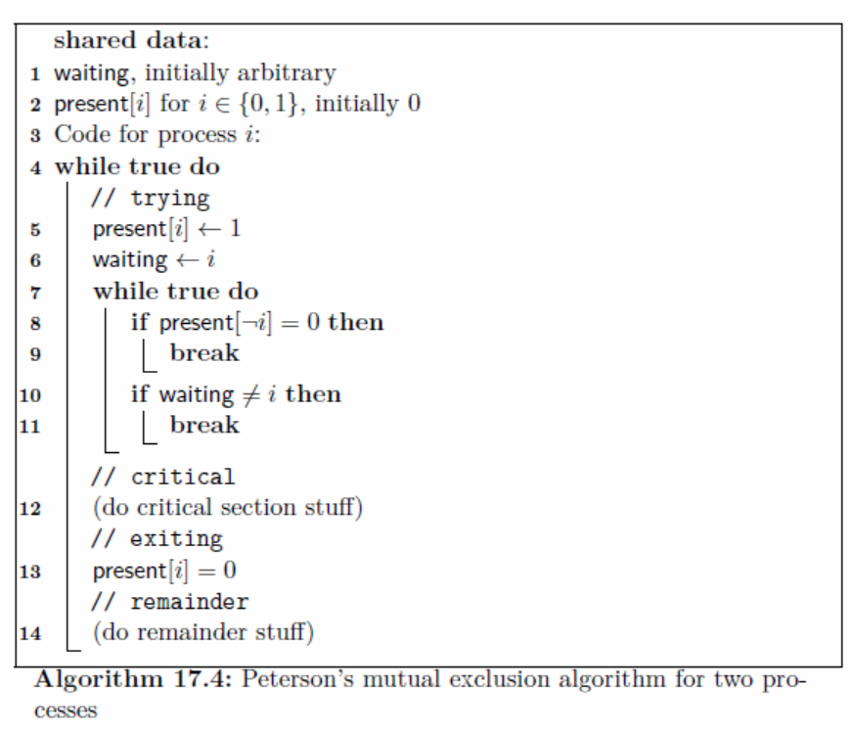
Mutual exclusion using only atomic registers

Slide 8
1. Safety property The safety property states that at any instant, only one process can execute the critical section. This is an essential property of a mutual exclusion algorithm.
2. Liveness property This property states the absence of deadlock and starvation. Two or more sites should not endlessly wait for messages that will never arrive. In addition, a site must not wait indefinitely to execute the CS while other sites are repeatedly executing the CS. That is, every requesting site should get an opportunity to execute the CS in finite time.
3. Fairness Fairness in the context of mutual exclusion means that each process gets a fair chance to execute the CS. In mutual exclusion algorithms, the fairness property generally means that the CS execution requests are executed in order of their arrival in the system (the time is determined by a logical clock).

Slide 9
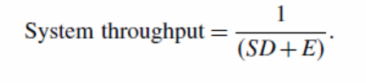
Performance Metrics
Message complexity This is the number of messages that are required per CS execution by a site.
• Synchronization delay After a site leaves the CS, it is the time required and before the next site enters the CS). Note that normally one or more sequential message exchanges may be required after a site exits the CS and before the next site can enter the CS.
• Response time This is the time interval a request waits for its CS execution to be over after its request messages have been sent out. Thus, response time does not include the time a request waits at a site before its request messages have been sent out.
• System throughput This is the rate at which the system executes requests for the CS. If SD is the synchronization delay and E is the average critical section execution time, then the throughput is given by the following equation:

Slide 10
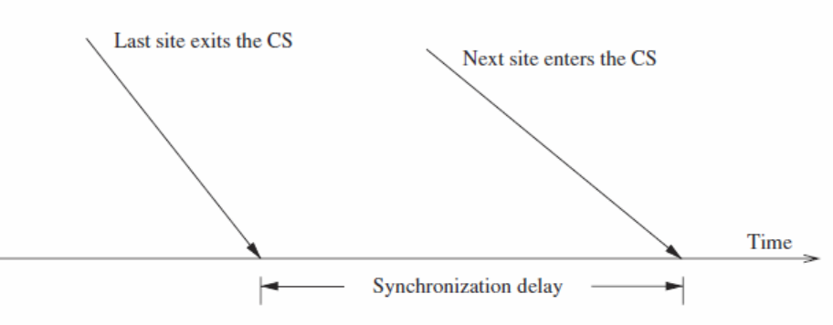
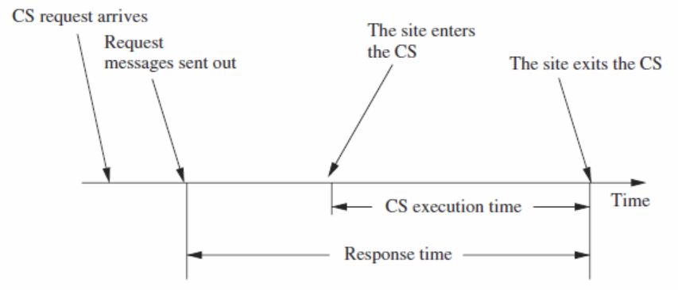

Slide 11
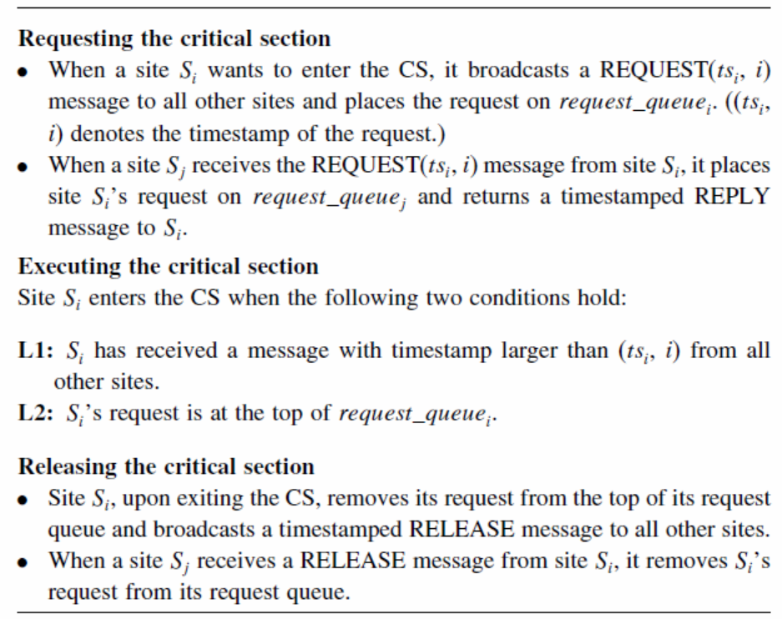
Lamport’s Algorithm

Slide 12
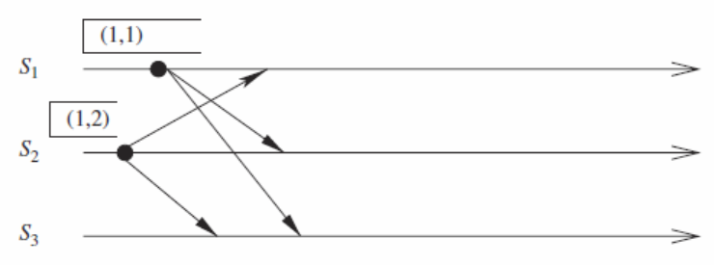
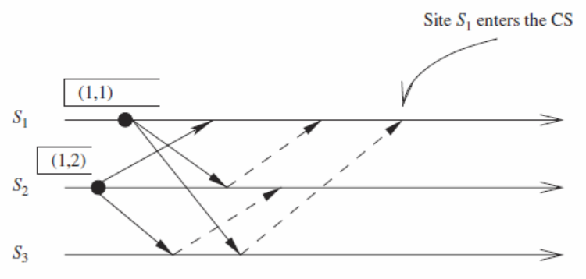

Slide 13
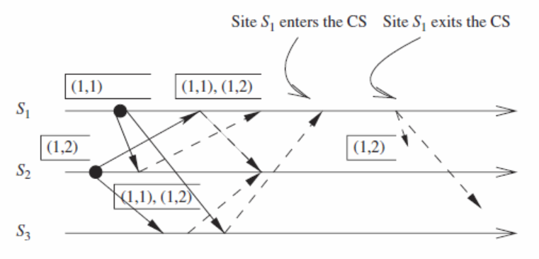
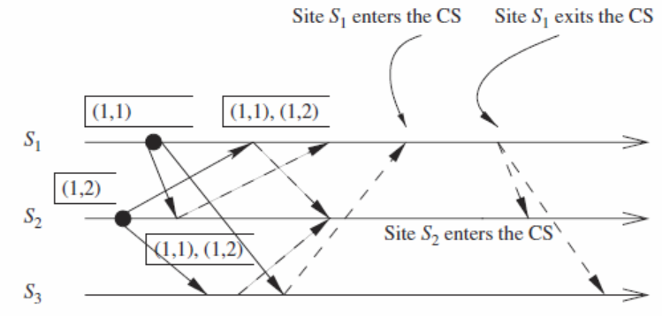

Slide 14
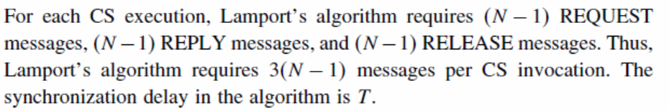
Performance
بهینه سازی: عدم ارسال پاسخ
کاهش تعداد پیام بین 2(N-1) و 3(N-1)

Slide 15
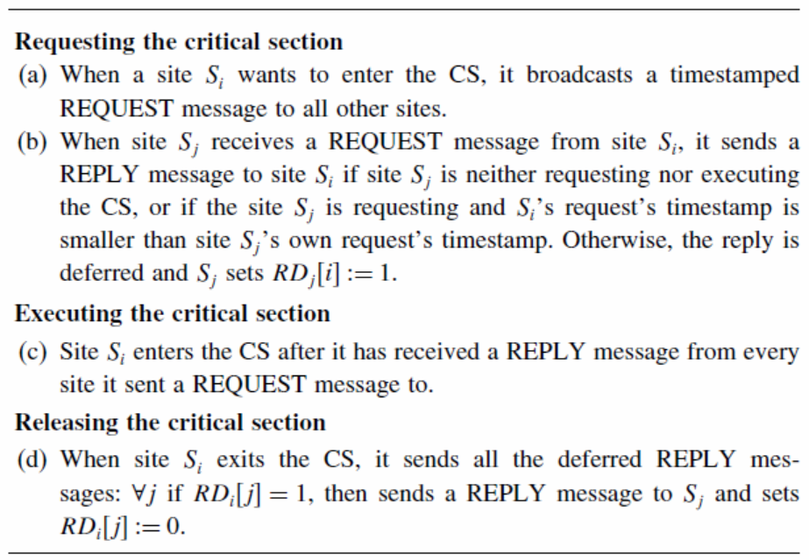
Ricart–Agrawala algorithm

Slide 16
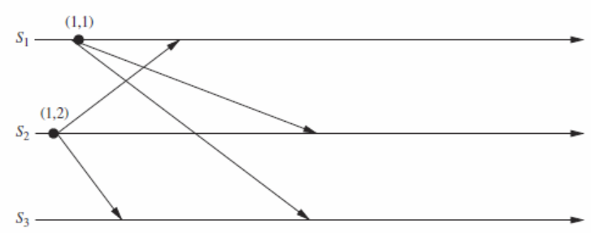

Slide 17
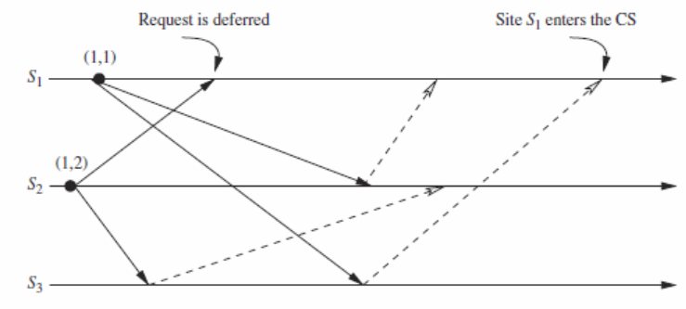

Slide 18
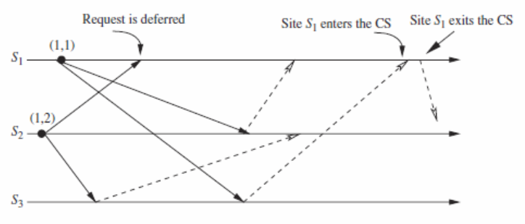

Slide 19
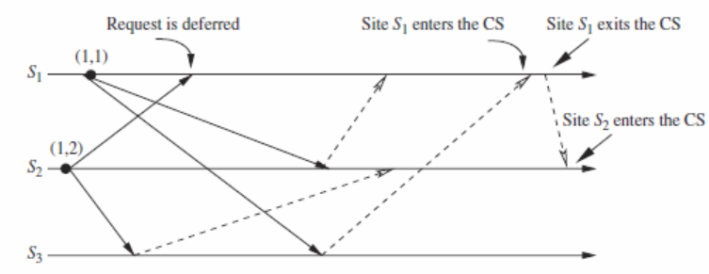

Slide 20
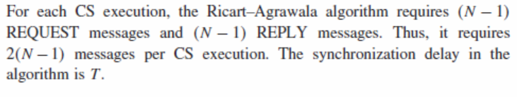
Performance

Slide 21
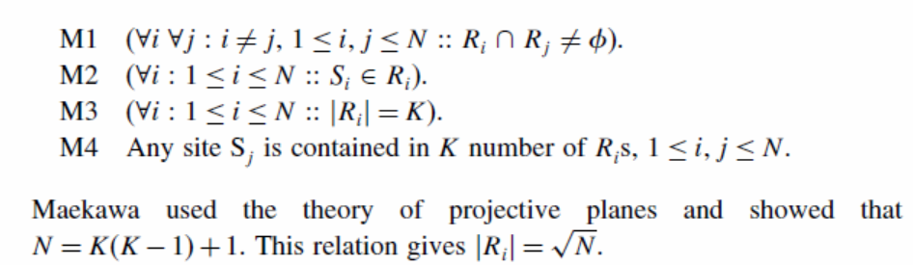
Quorum-based mutual exclusion algorithms
Maekawa’s algorithm

Slide 22
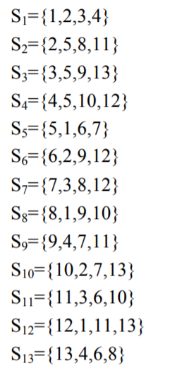
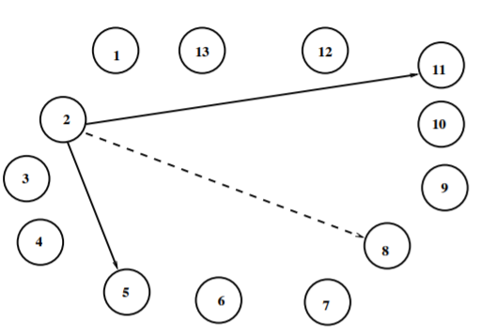

Slide 23
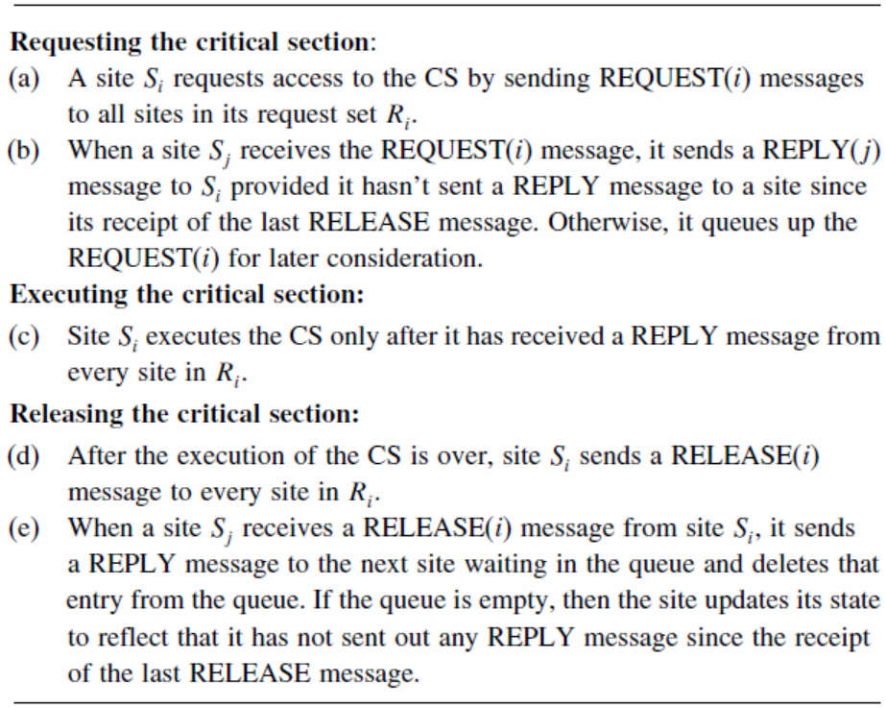

Slide 24
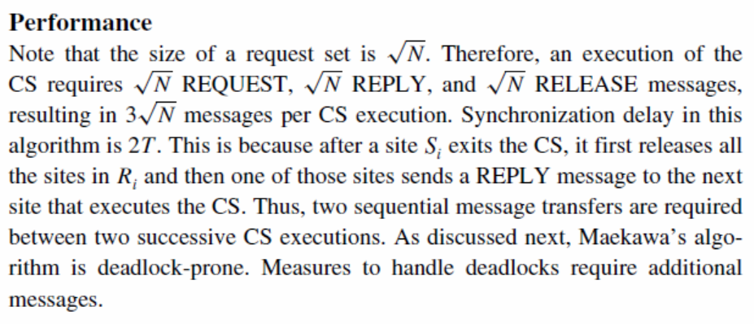

Slide 25
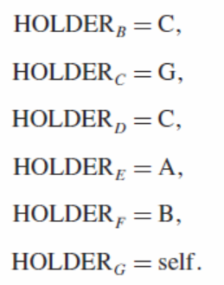
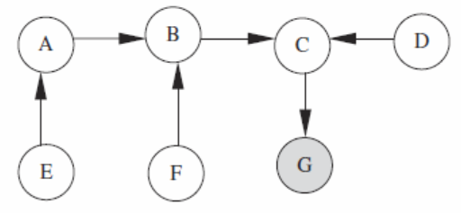
Token-based algorithms
Raymond’s tree-based algorithm

Slide 26
تمرین
در خصوص احتمال رخداد بن بست در الگوریتم میکاوا بحث کنید؟
نشان دهید که در چه حالتی و با چه توپولوژی بهترین پیچیدگی پیامی در الگوریتم ریموند به دست می آید؟

Slide 27
مرجع
فصل 17 کتاب Aspnes
فصل 9 کتاب Singhal

